Slide 1
Neural
Ordinary Differential Equations
Motivation and Background

Slide 2
Purpose of Applied Math
Represent physical world mathematically
Draw conclusions about physical world from models we create

Slide 3
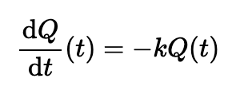



ODEs as Models
Radioactive Decay
Population (General)
Economic Growth (Solow’s)
Newtonian Mechanics
Notes:
https://math.stackexchange.com/questions/4138816/compartmental-models
https://personal.math.ubc.ca/~CLP/CLP1/clp_1_dc/ssec_carbon.html#:~:text=Q(t).-,d%20Q%20d%20t%20(%20t%20)%20%3D%20K%20Q%20(%20t,by%20K%3D%E2%88%92k%20).
https://www.math.tamu.edu/~efendiev/math647_spring05/model_ode.pdf

Slide 4
Principled Physical Model/ODE Creation
Determine parameters based on our understanding of what the model represents
E.g. water has density of ~1g/mL, US GDP growth is ~2%/year
Notes:
Transition to ML: don’t always have simple ways to determine parameters; in these cases, we rely on data-driven approaches instead! Working with ODEs in this way is still very much possible, but another method of model creation based upon data is machine learning…

Slide 5
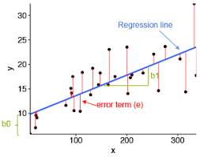
Purpose of Machine Learning
Understand physical world from data
Make data-driven predictions and decisions
Recommendation systems
Weather forecasting
Election results predictions
Many more applications…
Follows process similar to (but much more complex than) linear regression
Find “line” which has minimum error across all data points
Notes:
https://www.analyticsvidhya.com/blog/2021/05/all-you-need-to-know-about-your-first-machine-learning-model-linear-regression/

Slide 6
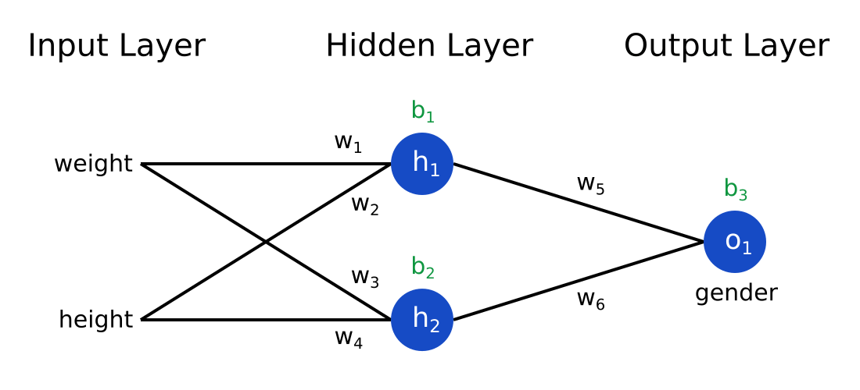
Neural Networks
Machine Learning process designed similarly to human brains’ function
Makes predictions based on data
Image recognition
Sales forecasting
Medical diagnosis
Many others applications…
Correct weights and biases must be found
These are parameters which must be determined!
football position
Notes:
https://victorzhou.com/blog/intro-to-neural-networks/

Slide 7
Data-Driven Physical Model/ODE Creation
Determine parameters based on data collected from the physical world
E.g. population growth data, financial trading data, voting record data
Goal is to minimize error between data and the solution curve
Parameters are tuned to achieve this
Notes:
Everything’s about determining parameters

Slide 8

Issues with a Data-Driven Approach:
It’s difficult to determine the parameters of the model!
Population (General)
The solution p(t) will contain these parameters, too – must determine what they are to best fit the data!
Analytical Solution may not always exist!
, but most useful models are not this pretty – and have WAY more parameters!

Slide 9
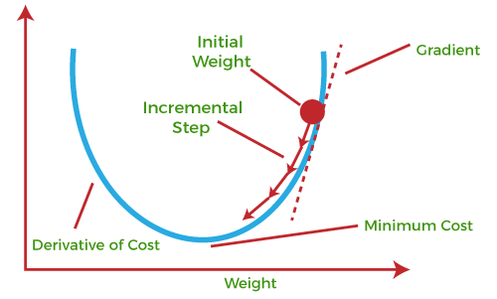
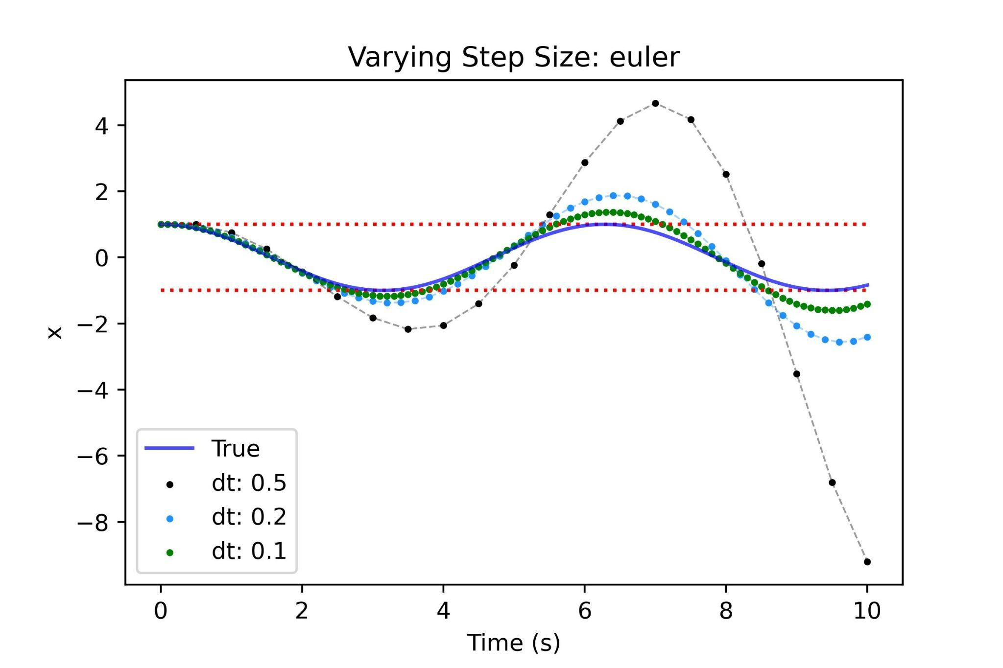
Applied Mathematics Solutions to these Issues
Parameter tuning solution:
Gradient Descent for Optimal Control
Analytical Solution DNE solution:
Time Integrators
Notes:
https://www.javatpoint.com/gradient-descent-in-machine-learning
https://patrickyoussef.com/blog/integrator-intro/

Slide 10
Gradient Descent & Optimal Control
Applied mathematics fields dating back decades
Optimal Control: Processes of optimizing an objective function that represents a dynamical system
Gradient Descent: Process for finding parameters which minimize a differentiable function

Slide 11
How They Apply
y’(t) = f(y(t),t;Θ) – arbitrary ODE
Our goal: find parameters Θ to the solution function y(t) that best fits our data
Stated differently:
Determine parameters Θ to the solution function y(t) that minimizes the error between y(t) and our data
Big Idea:
Use gradient descent to minimize the error function of y(t) and data!
Requires derivative of the error function

Slide 12
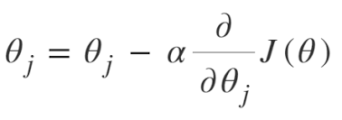
Steps to Gradient Descent
E
1.
3.
Need:
Solution to ODE (analytical or numerical): h(t)
Error b/t solution and data: E(Θ) = ∑(h(t)-y(t))^2
y(t) is real-world data
Derivative of error: E’(Θ)
Steps
Make initial parameter (Θ) guess
Evaluate negative gradient of the derivative of the error function
Move Θ slightly (𝛼) in direction of the evaluated gradient
Repeat!
2.
Notes:
https://www.geeksforgeeks.org/difference-between-batch-gradient-descent-and-stochastic-gradient-descent/

Slide 13
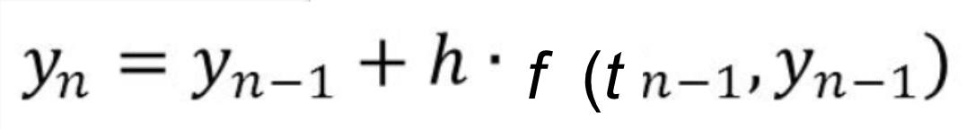
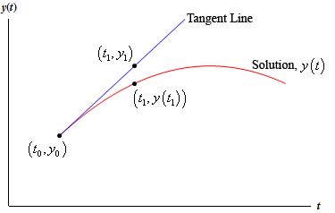
ODE Numerical Solution Methods: Time Integration
Time Integrators: methods of solving complex ODEs
Given y’ = f(y);
Euler’s Method
Runge-Kutta (RK4)
Results:
Data in form of (t_i, y_i)
h
Notes:
https://tutorial.math.lamar.edu/classes/de/eulersmethod.aspx

Slide 14
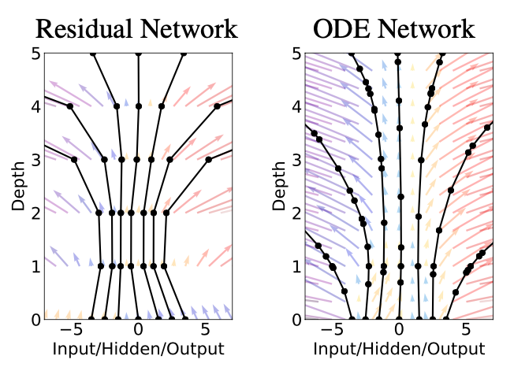
Bringing it all Together
(Neural Network)
limit
(ODE)
N(y(t);Θ)
y’(t) = f(y(t);Θ)
Then apply optimal control
Time Integration
Gradient Descent
Avoids bottlenecks or other issues with standard NNs

Slide 15
Results (High-Level) of Neural ODEs
Memory efficiency
Avoids backpropagation through operations of solver (constant memory cost)
Adaptive computation
Users have agency over which ODE solver to use
Using well-known ODE solvers (Euler, RK4, etc.) allows for control over error properties
Helpful for researchers; scale cost with problem complexity
Continuous time neural network
Layers/intervals are not required to be discretized
ODEs’ continuously defined dynamics naturally allow for continuous NN layers
Offers greater data/prediction flexibility

